Slide 1


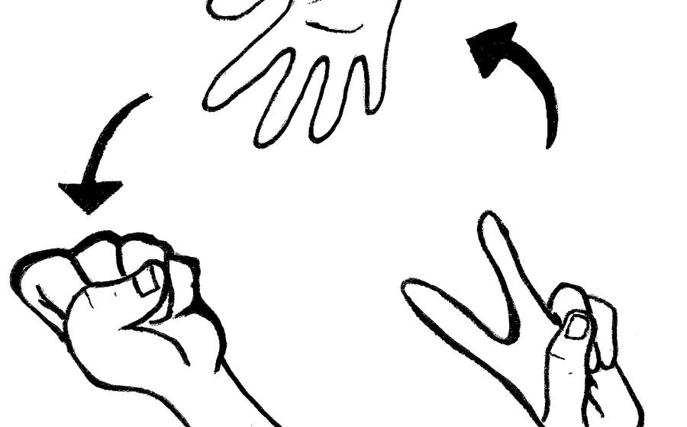
TEST CASES DESIGN FLOW
ROCK
PAPER
SCISSORS
This Photo by Unknown Author is licensed under CC BY

Slide 2


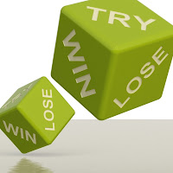
FIRST STAGE
REQUIREMENTS
COMPUTER
TWO PLAYERS
COMMANDS

Slide 3
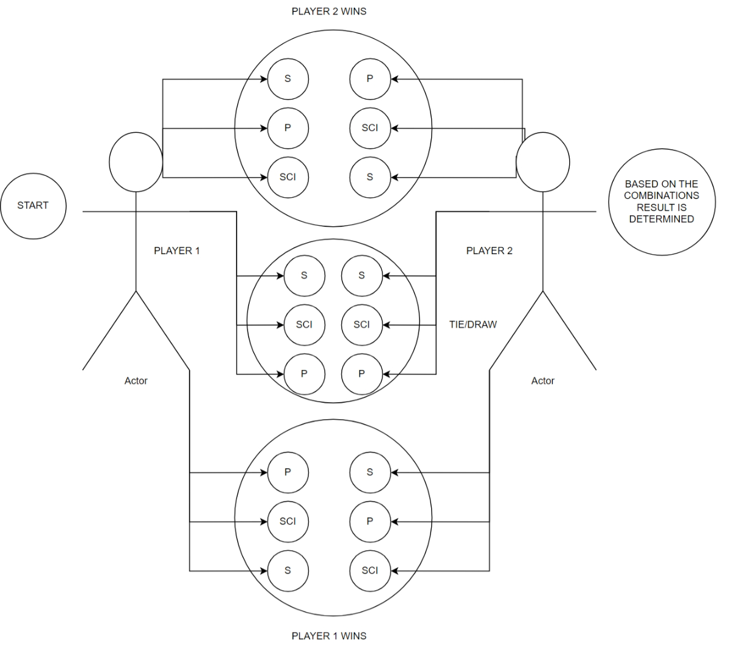
Usecase Diagram

Slide 4
White Box
Game initialization
Players involved - CPU - Player, Player1 - Player2
If P1 is a CPU - Check if the probabilities for rock, paper and scissors are assigned the same
Verify if the game results are reset after each round (Per Round Score)
Verify if the score is calculated properly (Each Round, Wins = +1, Lose = -1, Tie = 0)
Verify if the score is registered properly (Cumulative Score)
Score is given for the valid combinations (If user doesn’t register input within the time frame)
To ensure all the commands are functioning appropriately

Slide 5
Black Box
To check if the game starts properly
To check if the input is being registered by the player within the specific time frame
Decision Making
Input (P1 - P2) | Expected Output
Rock - Rock | Tie
Scissors - Scissors | Tie
Paper - Paper | Tie
Rock - Scissors | Player 1 Wins
Paper - Rock | Player 1 Wins
Scissors - Paper | Player 1 Wins
Scissors - Rock | Player 2 Wins
Rock - Paper | Player 2 Wins
Paper - Scissors | Player 2 Wins

Slide 6
Thank You

